Slide 1
Hi! This is CS50.
If just added, see cs50.harvard.edu for website. Email heads@cs50.harvard.edu with questions.
Today's lecture is 3pm–5pm. We'll take a short break (with cookies) partway through.
See website after lecture for Quiz 1, due tomorrow (Tue 9/10) at 9am.
See website for sectioning form, due tomorrow (Tue 9/10) at 11:59pm.
If you have trouble seeing projector, see live.cs50.io/screen for a live feed.
See website after lecture for Problem Set 1, due Sun 9/14 at 11:59pm.
Attend Orientation tomorrow (Tue 9/10) or Wed 9/11, 4:30pm–5:45pm, in Emerson 105.
Optionally attend Brian's Supersection tonight at 7:30pm via Zoom, per website.

Slide 2
This is CS50

Slide 3
#include <stdio.h>
int main(void) {
printf("hello, world");
}

Slide 4
2/3
of CS50 students have never taken CS before

Slide 5
#include <stdio.h>
int main(void) {
printf("hello, world");
}

Slide 6
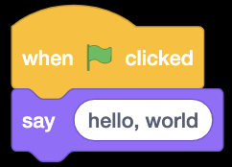

Slide 7
functions
conditions
Boolean expressions
loops

Slide 8
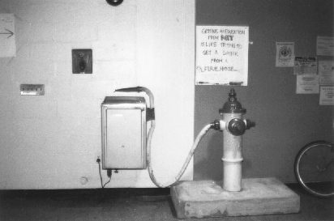
Notes:
1991
``Getting an Education from MIT is like taking a drink from a Fire Hose.'' http://hacks.mit.edu/Hacks/by_year/1991/fire_hydrant/

Slide 9
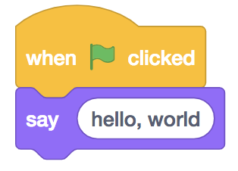
#include <stdio.h>
int main(void) {
printf("hello, world");
}

Slide 11
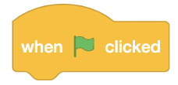
int main(void) {
}

Slide 12
int main(void) {
}

Slide 14
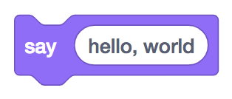
printf("hello, world");

Slide 15
printf("hello, world");

Slide 16
printf("hello, world");

Slide 17
printf("hello, world");

Slide 18
printf("hello, world");

Slide 19
printf("hello, world");

Slide 21
#include <stdio.h>
int main(void) {
printf("hello, world");
}

Slide 22
#include <stdio.h>
int main(void) {
printf("hello, world");
}

Slide 23
#include <stdio.h>
int main(void) {
printf("hello, world");
}
Notes:
hello.c

Slide 24
CS50 Sandbox
sandbox.cs50.io

Slide 25
cd
ls
mkdir
rm
rmdir
...

Slide 26
#include <stdio.h>
int main(void) {
printf("hello, world");
}

Slide 27
01111111 01000101 01001100 01000110 00000010 00000001 00000001 00000000 00000000 00000000 00000000 00000000 00000000 00000000 00000000 00000000 00000010 00000000 00111110 00000000 00000001 00000000 00000000 00000000 10110000 00000101 01000000 00000000 00000000 00000000 00000000 00000000 01000000 00000000 00000000 00000000 00000000 00000000 00000000 00000000 11010000 00010011 00000000 00000000 00000000 00000000 00000000 00000000 00000000 00000000 00000000 00000000 01000000 00000000 00111000 00000000 00001001 00000000 01000000 00000000 00100100 00000000 00100001 00000000 00000110 00000000 00000000 00000000 00000101 00000000 00000000 00000000 01000000 00000000 00000000 00000000 00000000 00000000 00000000 00000000 01000000 00000000 01000000 00000000 00000000 00000000 00000000 00000000 01000000 00000000 01000000 00000000 00000000 00000000 00000000 00000000 11111000 00000001 00000000 00000000 00000000 00000000 00000000 00000000 11111000 00000001 00000000 00000000 00000000 00000000 00000000 00000000 00001000 00000000 00000000 00000000 00000000 00000000 00000000 00000000 00000011 00000000 00000000 00000000 00000100 00000000 00000000 00000000 00111000 00000010 00000000 00000000 00000000 00000000 00000000 00000000 ...

Slide 28
input →
→ output

Slide 30
source code →

Slide 31
source code →
→ machine code

Slide 32
compiler
source code →
→ machine code

Slide 33
#include <stdio.h>
int main(void) {
printf("hello, world");
}

Slide 34
#include <stdio.h>
int main(void) {
printf("hello, world\n");
}

Slide 35
clang hello.c
./a.out

Slide 36
clang -o hello hello.c
./hello

Slide 38
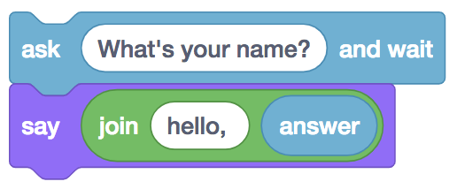
string answer = get_string("What's your name?\n");
printf("hello, %s", answer);

Slide 39
string answer = get_string("What's your name?\n");
printf("hello, %s", answer);

Slide 40
string answer = get_string("What's your name?\n");
printf("hello, %s", answer);

Slide 41
string answer = get_string("What's your name?\n");
printf("hello, %s", answer);

Slide 42
string answer = get_string("What's your name?\n");
printf("hello, %s", answer);

Slide 43
string answer = get_string("What's your name?\n");
printf("hello, %s", answer);

Slide 44
string answer = get_string("What's your name?\n");
printf("hello, %s\n", answer);

Slide 45
string answer = get_string("What's your name?\n");
printf("hello, %s\n", answer);

Slide 46
string answer = get_string("What's your name?\n");
printf("hello, %s\n", answer);
Notes:
string.c

Slide 47
clang -o hello hello.c -lcs50
./hello

Slide 48
make hello
./hello

Slide 50
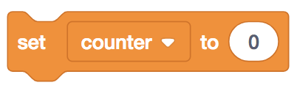
int counter = 0;

Slide 51
int counter = 0;

Slide 52
int counter = 0;

Slide 53
int counter = 0;

Slide 54
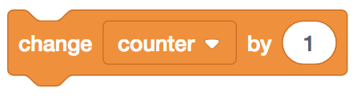
counter = counter + 1;

Slide 55
counter = counter + 1;

Slide 56
counter = counter + 1;

Slide 57
counter += 1;

Slide 58
counter++;

Slide 60
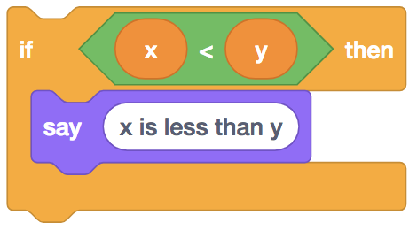
if (x < y) {
printf("x is less than y\n");
}

Slide 61
if (x < y) {
printf("x is less than y\n");
}

Slide 62
if (x < y) {
printf("x is less than y\n");
}

Slide 64
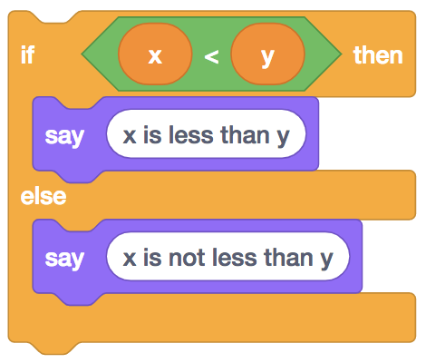
if (x < y) {
printf("x is less than y\n");
}
else
{ printf("x is not less than y\n");
}

Slide 65
if (x < y) {
printf("x is less than y\n");
}
else
{ printf("x is not less than y\n");
}

Slide 66
if (x < y) {
printf("x is less than y\n");
}
else
{ printf("x is not less than y\n");
}

Slide 68
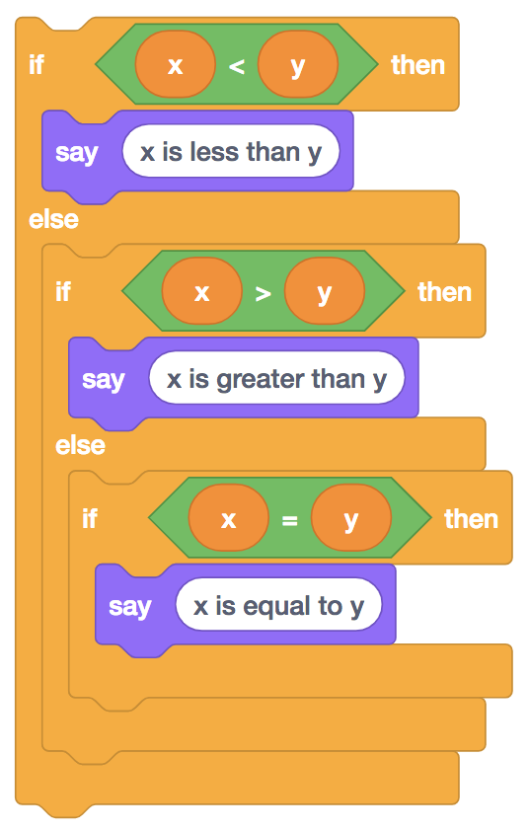
if (x < y) {
printf("x is less than y\n");
}
else if (x > y)
{ printf("x is greater than y\n");
}
else if (x == y)
{ printf("x is equal to y\n");
}

Slide 69
if (x < y) {
printf("x is less than y\n");
}
else if (x > y)
{ printf("x is greater than y\n");
}
else if (x == y)
{ printf("x is equal to y\n");
}

Slide 70
if (x < y) {
printf("x is less than y\n");
}
else if (x > y)
{ printf("x is greater than y\n");
}
else if (x == y)
{ printf("x is equal to y\n");
}

Slide 71
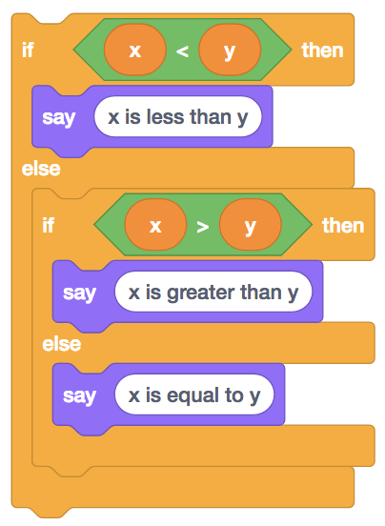
if (x < y) {
printf("x is less than y\n");
}
else if (x > y)
{ printf("x is greater than y\n");
}
else
{ printf("x is equal to y\n");
}

Slide 73
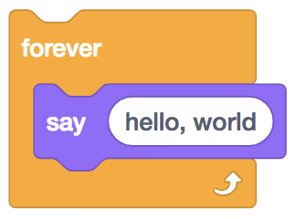
while (true)
{
printf("hello, world\n");
}

Slide 74
while (true)
{
printf("hello, world\n");
}

Slide 75
while (true)
{
printf("hello, world\n");
}

Slide 76
while ( )
{
printf("hello, world\n");
}

Slide 77
while (true)
{
printf("hello, world\n");
}

Slide 79
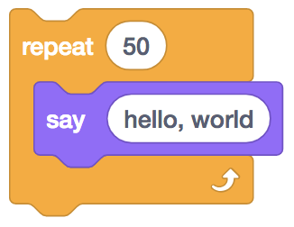
for (int i = 0; i < 50; i = i + 1)
{
printf("hello, world\n");
}

Slide 80
int counter = 0;
while (n > 0)
{
printf("hello, world\n");
i = i + 1;
}

Slide 81
int i = 0;
while (n > 0)
{
printf("hello, world\n");
i = i + 1;
}

Slide 82
int i = 0;
while (n > 0)
{
printf("hello, world\n");
i = i + 1;
}

Slide 83
int i = 0;
while (i < 50)
{
printf("hello, world\n");
i = i + 1;
}

Slide 84
int i = 0;
while (i < 50)
{
printf("hello, world\n");
i = i + 1;
}

Slide 85
int i = 0;
while (i < 50)
{
printf("hello, world\n");
i = i + 1;
}

Slide 86
int i = 0;
while (i < 50)
{
printf("hello, world\n");
i += 1;
}

Slide 87
int i = 0;
while (i < 50)
{
printf("hello, world\n");
i++;
}

Slide 88
int i = 50;
while (i > 0)
{
printf("hello, world\n");
i--;
}

Slide 89
for (int i = 0; i < 50; i = i + 1)
{
printf("hello, world\n");
}

Slide 90
for (int i = 0; i < 50; i = i + 1)
{
printf("hello, world\n");
}

Slide 91
for (int i = 0; i < 50; i = i + 1)
{
printf("hello, world\n");
}

Slide 92
for (int i = 0; i < 50; i = i + 1)
{
printf("hello, world\n");
}

Slide 93
for (int counter = 0; i < 50; i )
{
printf("hello, world\n");
}

Slide 94
for (int i = 0; i < 50; i = i + 1)
{
printf("hello, world\n");
}

Slide 95
for (int i = 0; i < 50; i = i + 1)
{
printf("hello, world\n");
}

Slide 96
for (int i = 0; i < 50; i = i + 1)
{
printf("hello, world\n");
}

Slide 97
for (int i = 0; i < 50; i += 1)
{
printf("hello, world\n");
}

Slide 98
for (int i = 0; i < 50; i++)
{
printf("hello, world\n");
}

Slide 99
bool
char
double
float
int
long
string
...

Slide 100
get_char
get_double
get_float
get_int
get_long
get_string
...

Slide 101
%c
%f
%i
%li
%s

Slide 102
%c char
%f float, double
%i int
%li long
%s string

Slide 103
+
-
*
/
%

Slide 104
+ addition
- subtraction
* multiplication
/ division
% remainder

Slide 105
manual pages

Slide 106
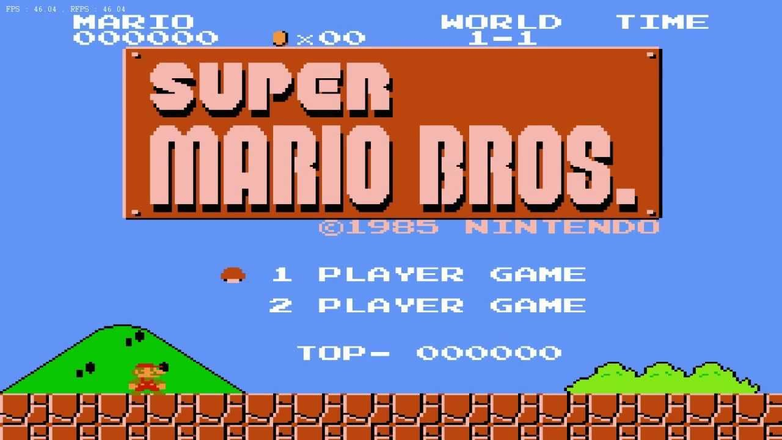

Slide 107
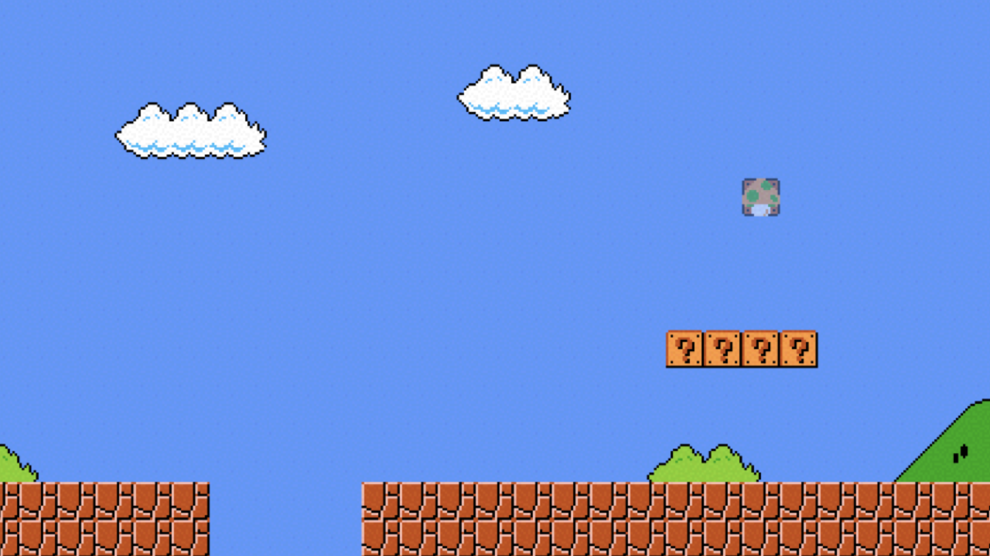

Slide 108
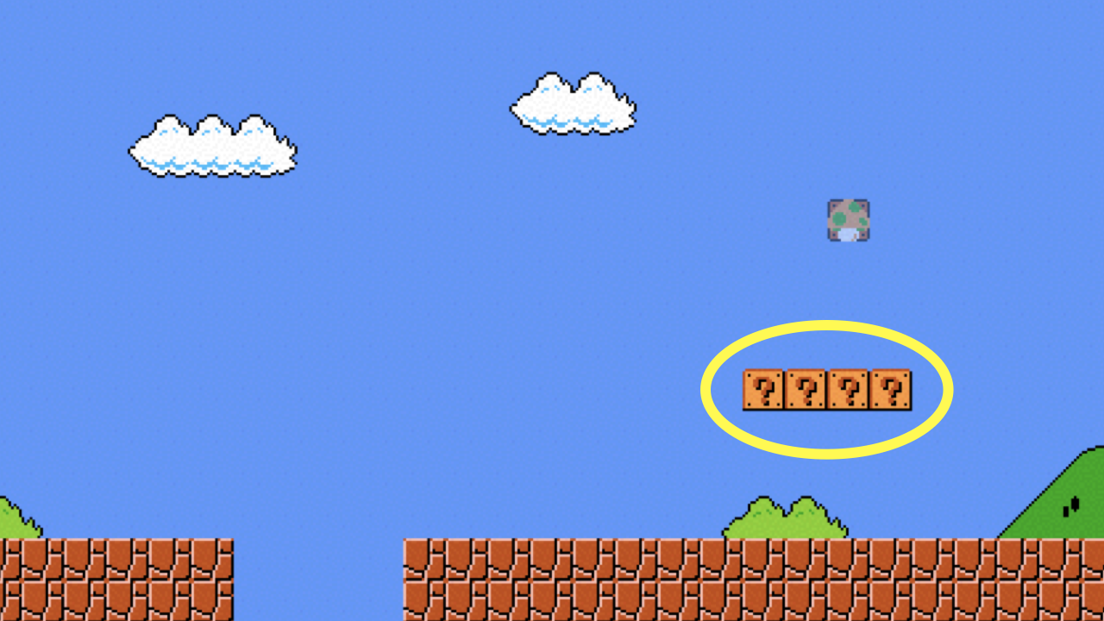
Notes:
mario0.c, mario1.c, mario2.c

Slide 109
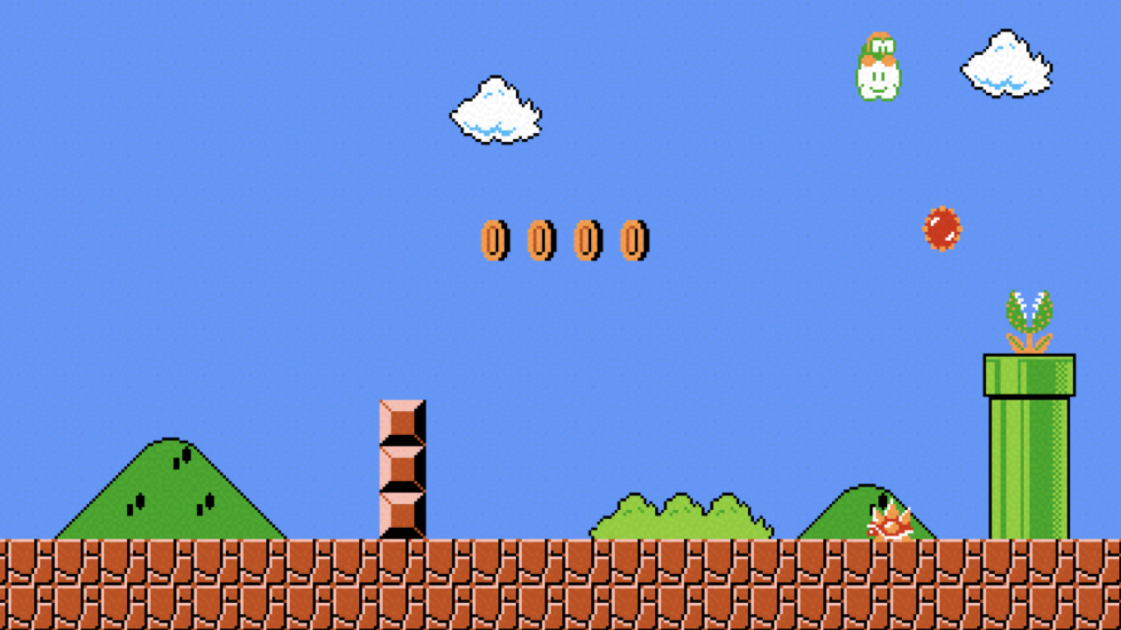

Slide 110
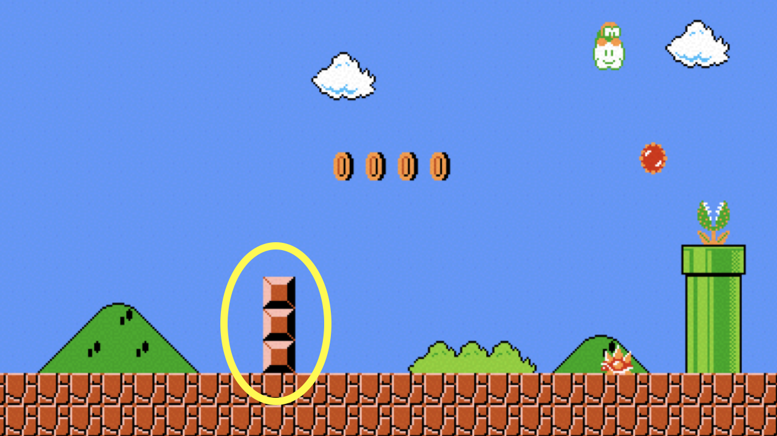
Notes:
mario3.c, mario4.c, mario5.c

Slide 111
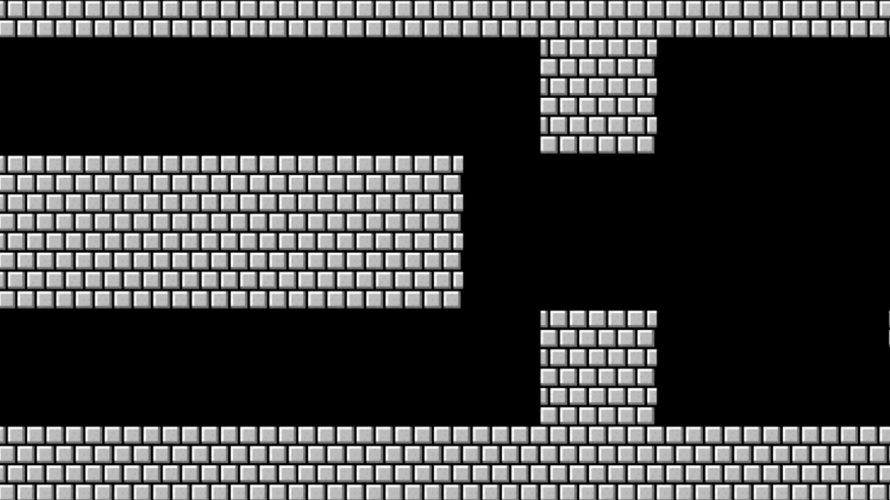

Slide 112
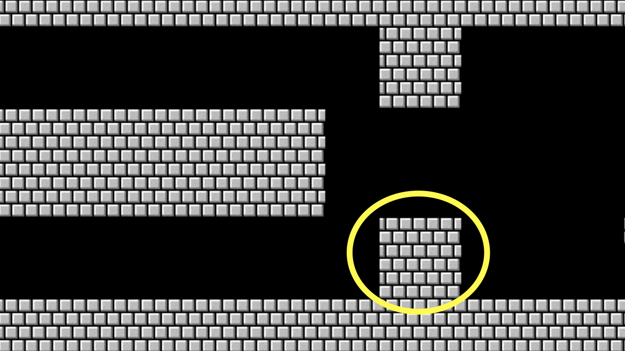
Notes:
mario6.c, mario7.c, mario8.c

Slide 113
CS50 Lab
lab.cs50.io

Slide 114
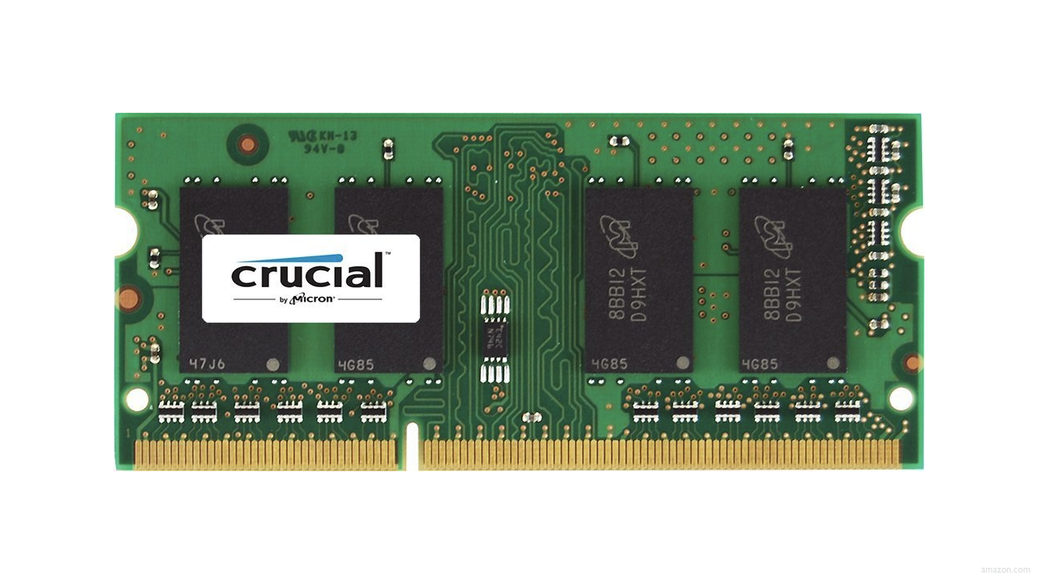

Slide 115
floating-point imprecision
Notes:
1.0 / 10.0

Slide 116
integer overflow

Slide 117
123

Slide 118
124

Slide 119
125

Slide 120
126

Slide 121
127

Slide 122
128

Slide 123
129

Slide 124
1
120

Slide 125
130

Slide 126
999

Slide 127
1
990

Slide 128
1
900

Slide 129
000

Slide 130
001

Slide 131
010

Slide 132
011

Slide 133
100

Slide 134
101

Slide 135
110

Slide 136
111

Slide 137
1
110

Slide 138
1
100

Slide 139
1
000

Slide 140
000

Slide 141
integer overflow

Slide 142
1999
Notes:
Y2K

Slide 143
1999

Slide 144
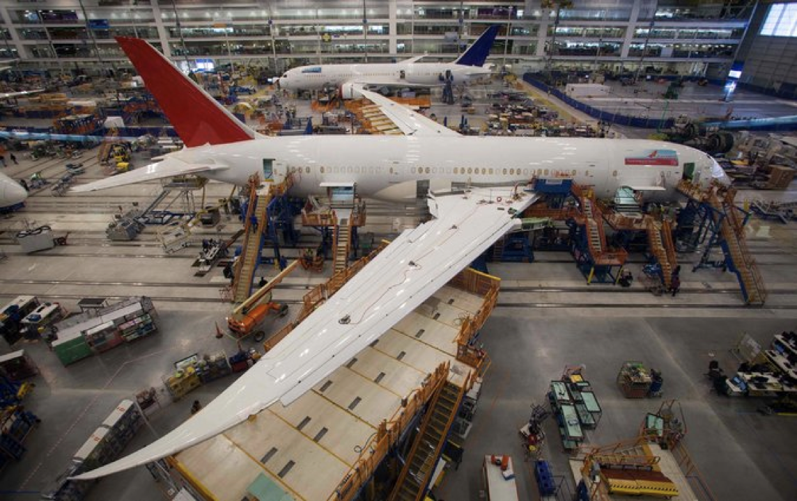
Notes:
Boeing 787
"a Model 787 airplane that has been powered continuously for 248 days can lose all alternating current (AC) electrical power due to the generator control units (GCUs) simultaneously going into failsafe mode," the memo stated. "This condition is caused by a software counter internal to the GCUs that will overflow after 248 days of continuous power... Boeing is in the process of developing a GCU software upgrade that will remedy the unsafe condition." - http://arstechnica.com/information-technology/2015/05/boeing-787-dreamliners-contain-a-potentially-catastrophic-software-bug/
A simple guess suggests the the problem is a signed 32-bit overflow as 2^31 is the number of seconds in 248 days multiplied by 100, i.e. a counter in hundredths of of a second.
https://www.i-programmer.info/news/149-security/8548-reboot-your-dreamliner-every-248-days-to-avoid-integer-overflow.html

Slide 145
1900

Slide 146
This is CS50
Notes:
figlet
say

